Slide 1
MATHEMATICS I
FIRST SEMESTER
07
Differentiation

Slide 2
Outlines
Derivative Function
Differentiation Rules
Second-and Higher-Order Derivatives
Derivatives of Trigonometric Functions
Derivative of the Sine Function
Derivative of the Cosine Function
Derivatives of the Other Basic Trigonometric Functions
The Chain Rule
Parametric Formula for
Parametric Formula for
Implicit Differentiation
dy dx
d ² y dx ²

Slide 3

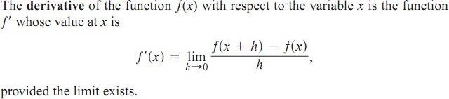
Differentiation
The process of calculating a derivative is called differentiation. The idea that differentiation is an operation performed on a function, we use the notation
as another way to denote the derivative
Derivative Function

Slide 4
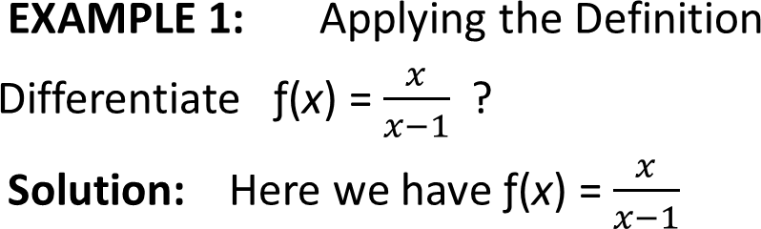
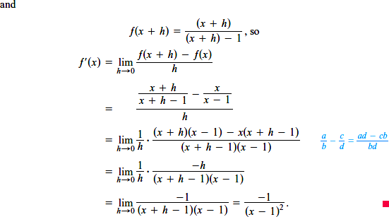

Slide 5

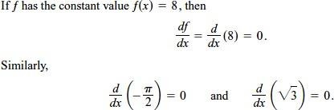
Differentiation Rules
This section introduces a few rules that allow us to differentiate a great variety of functions.
EXAMPLE 3:

Slide 6



EXAMPLE 4: Interpreting Rule 2

Slide 7


EXAMPLE 5:
The derivative formula

Slide 8

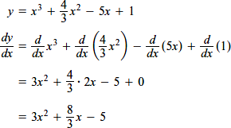

Derivative of a Sum
EXAMPLE 6:
EXAMPLE 7: Derivative of a Polynomial

Slide 9

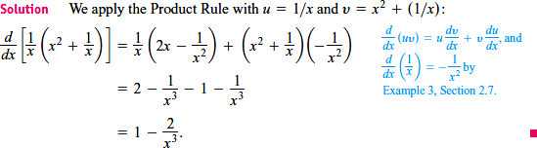
Using the Product Rule, Find the derivative of
EXAMPLE 8:

Slide 10
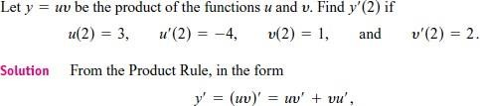

Derivative from Numerical Values
EXAMPLE :

Slide 11
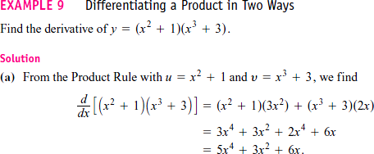


Slide 12
MATHEMATICS I
FIRST SEMESTER
08
Differentiation Rules

Slide 13
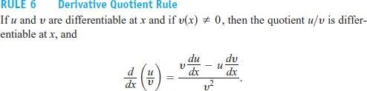

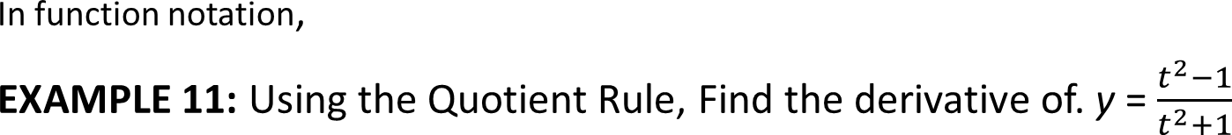
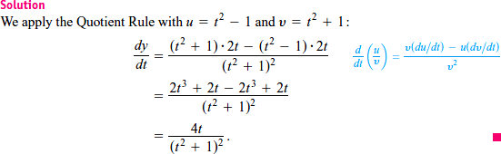

Slide 14


EXAMPLE 12:

Slide 15
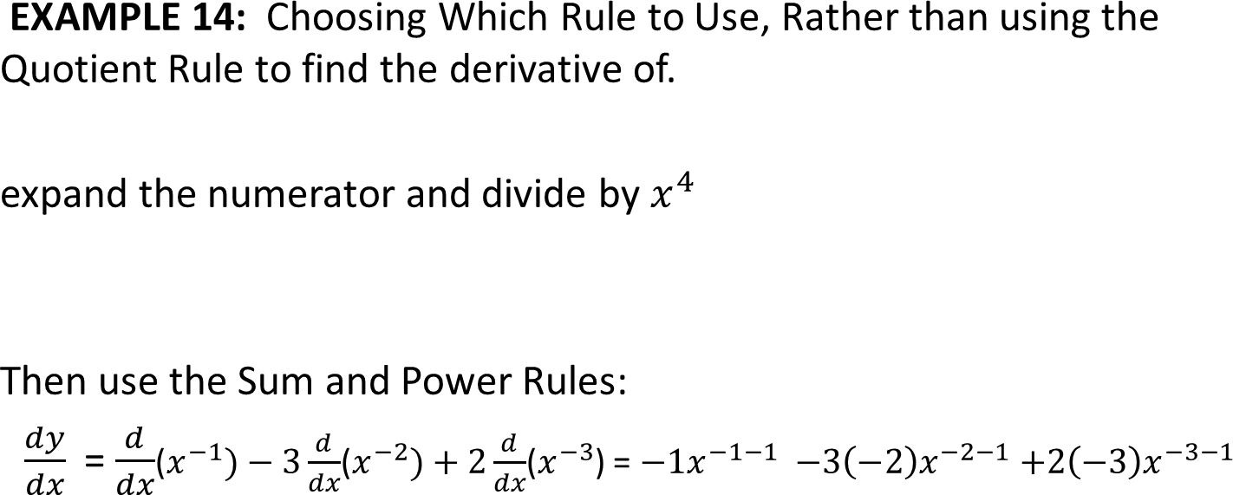




Slide 16
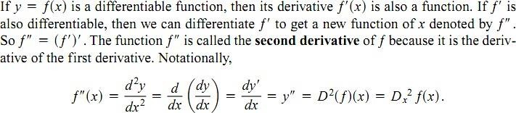
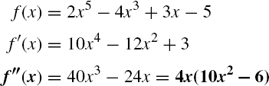
Second- and Higher-Order Derivatives

Slide 17
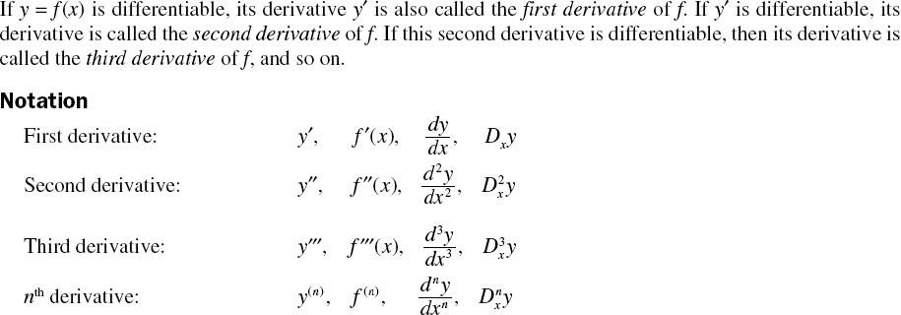

Slide 18
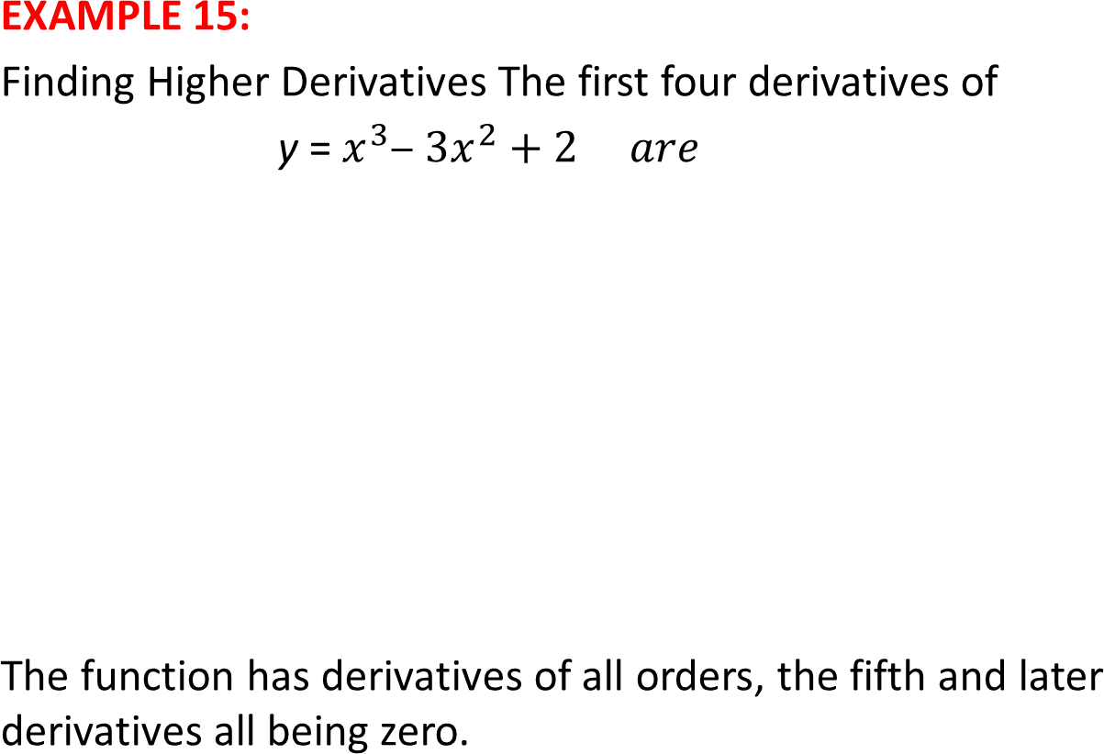


Slide 19
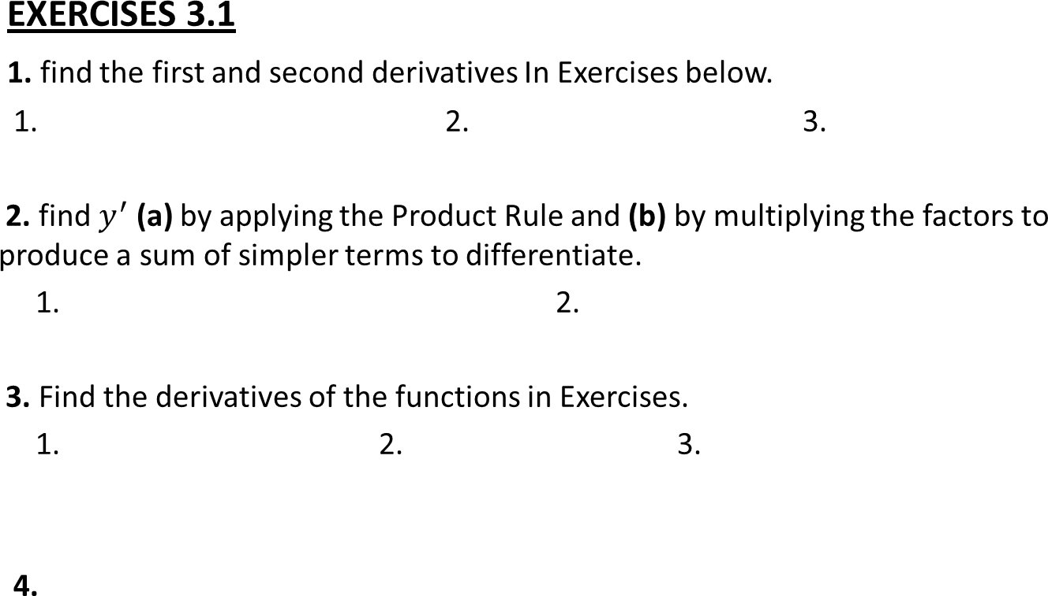






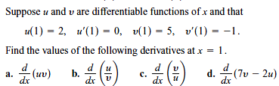

Slide 20



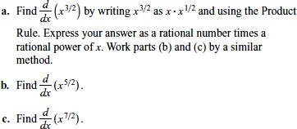
5. Find the first and second derivatives of the functions in Exercises.
1. 2. 3.
6.
7.
8.

Slide 21

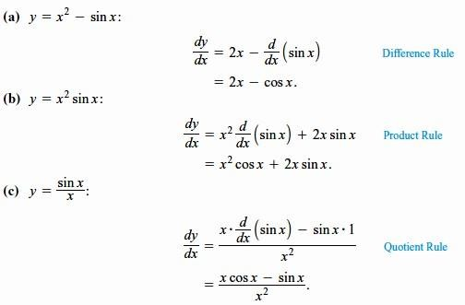
Derivatives of Trigonometric Functions
This section shows how to differentiate the six basic trigonometric functions.
- Derivative of the Sine Function:
EXAMPLE 1:
Derivatives Involving the Sine

Slide 22

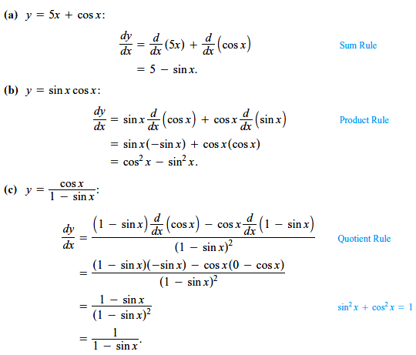
- Derivative of the Cosine Function:
EXAMPLE 2:
Derivatives Involving the Cosine

Slide 23
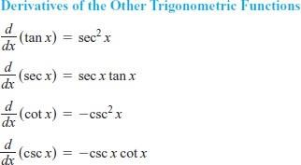
- Derivatives of the Other Basic Trigonometric Functions
Because sin x and cos x are differentiable functions of x, the related functions

Slide 24
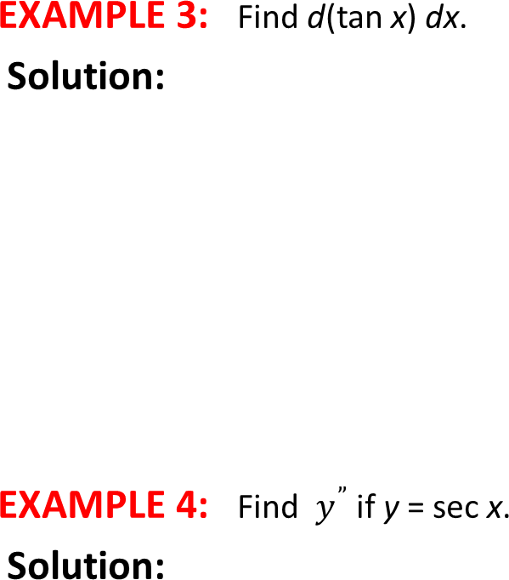
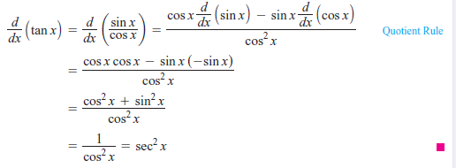
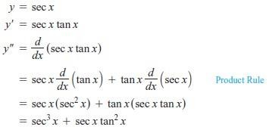

Slide 25
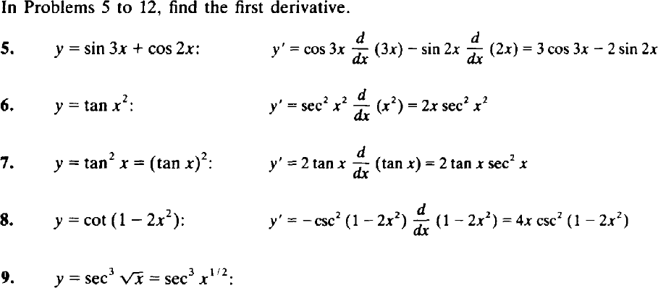

Slide 26
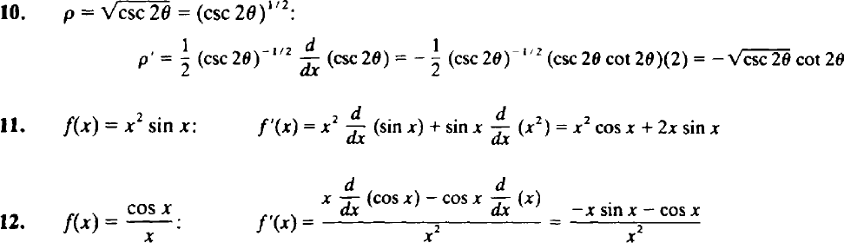
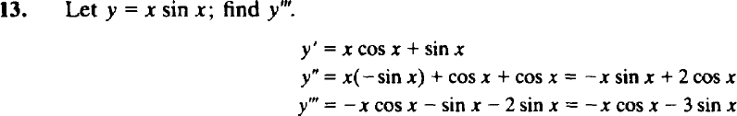

Slide 27
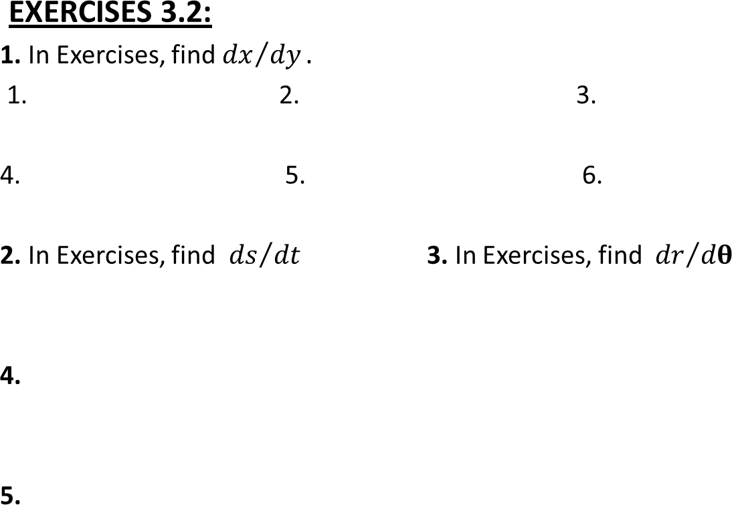









Slide 28
MATHEMATICS I
FIRST SEMESTER
09
Differentiation Rules

Slide 29
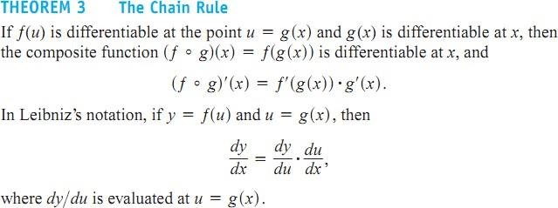
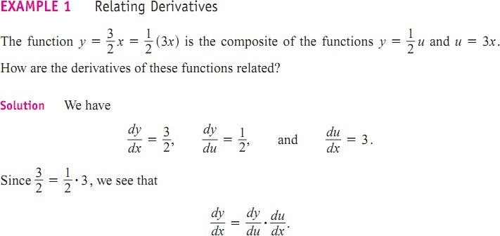
The Chain Rule

Slide 30
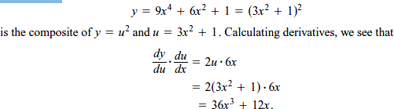
The function •
EXAMPLE 2:

Slide 31
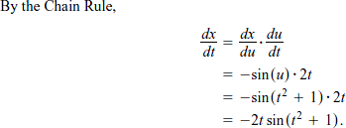

Applying the Chain Rule
EXAMPLE 3:

Slide 32
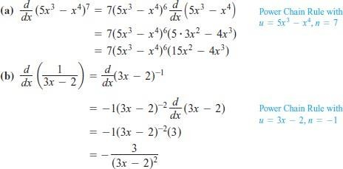
The Chain Rule with Powers of a Function
EXAMPLE :
Applying the Power Chain Rule

Slide 33
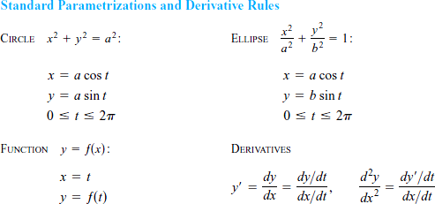

Parametric Equations
EXAMPLE 5: Moving Counterclockwise on a Circle, Graph the parametric curves.

Slide 34
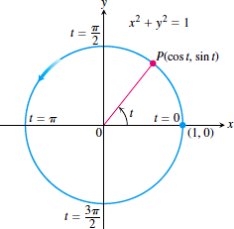
Solution:

Slide 35
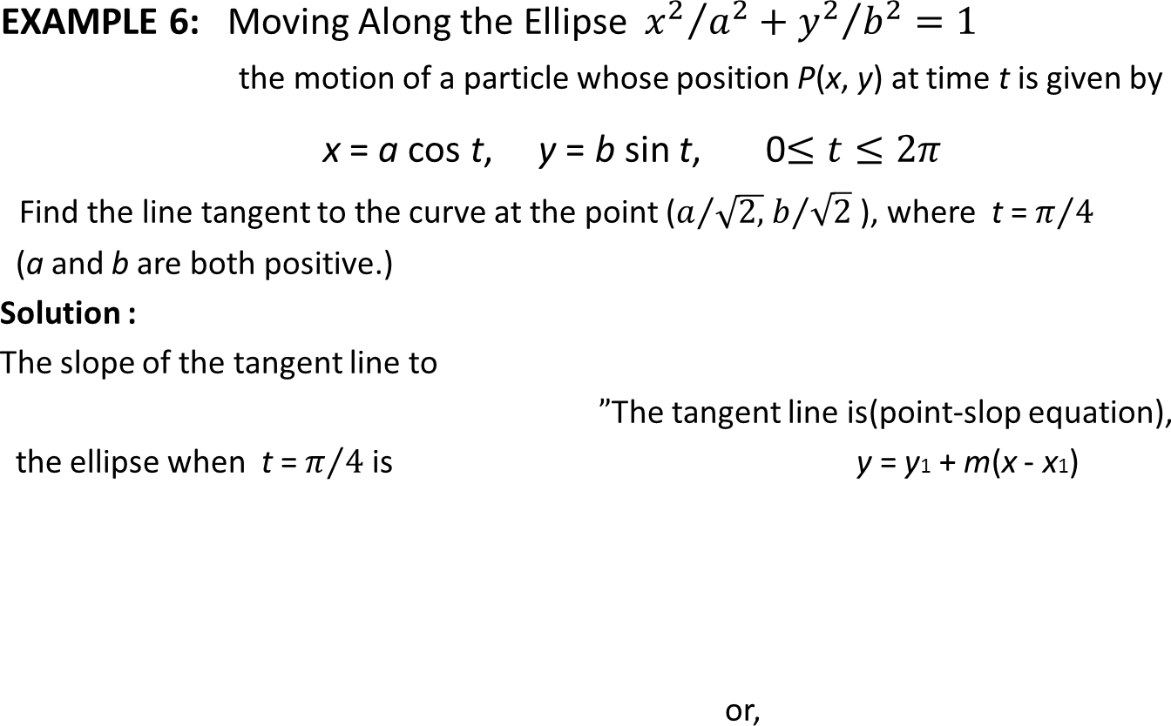
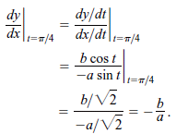


Slide 36
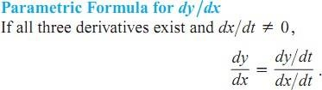
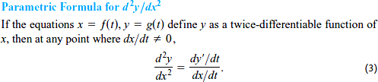
EXAMPLE :
EXAMPLE 7 :

Slide 37
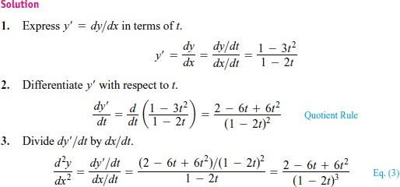

Slide 38
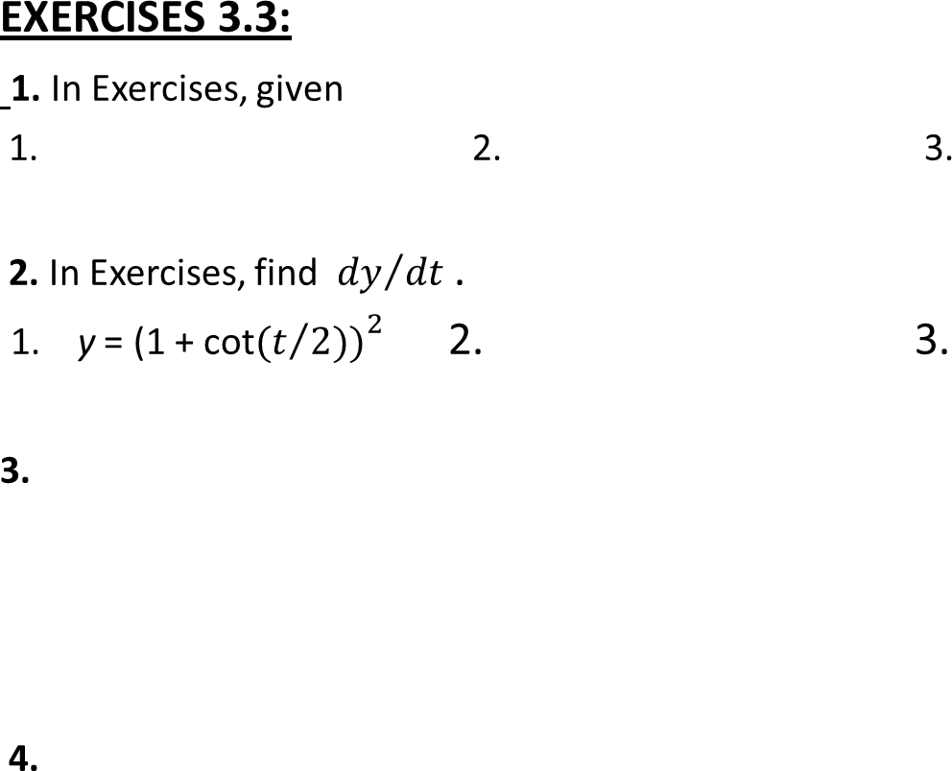




Slide 39
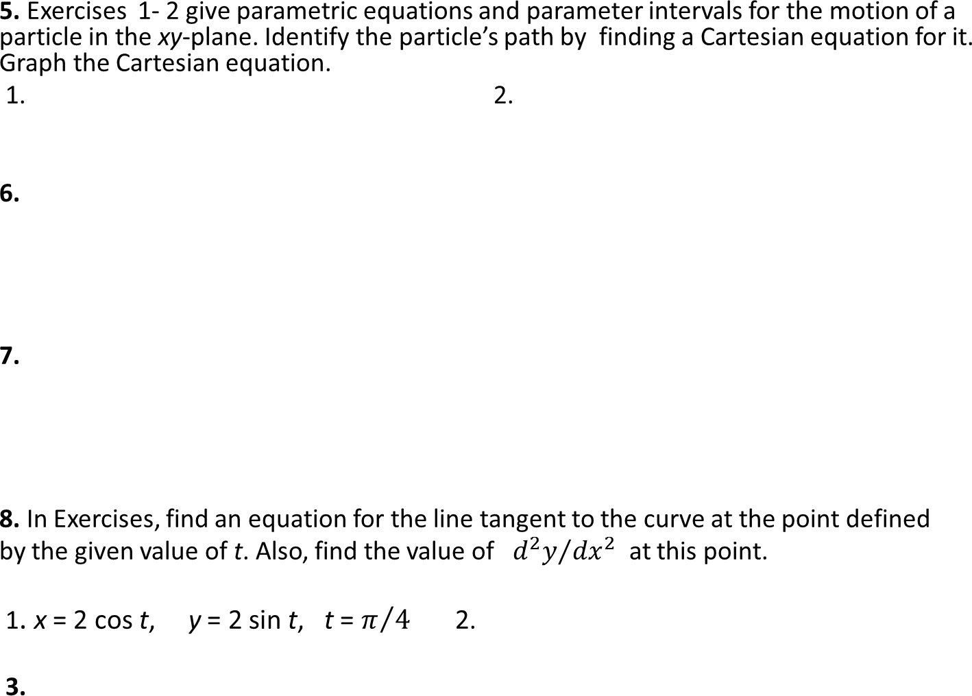

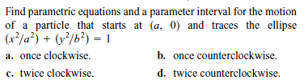

Slide 40
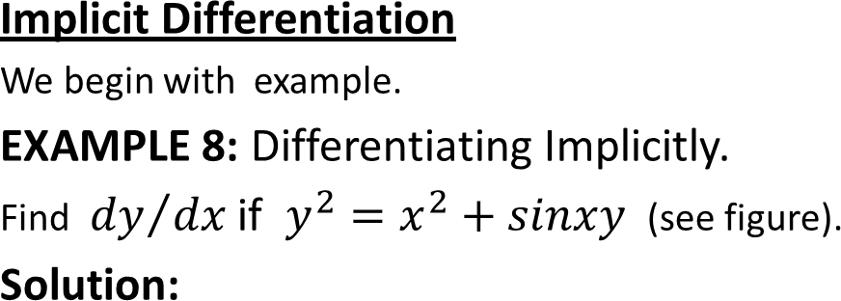
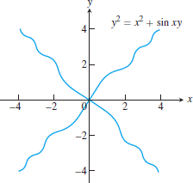
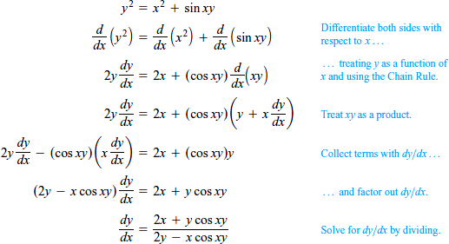

Slide 41
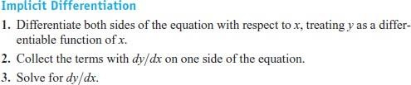
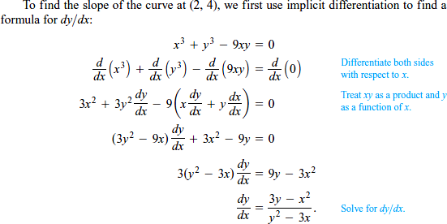

Slide 42
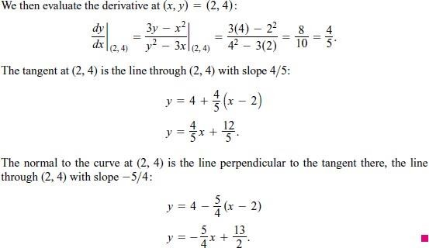
E
XAMPLE : Finding a Second Derivative Implicitly
EXAMPLE 10: Finding a Second Derivative Implicitly

Slide 43





